Slide 1
Human Lactation:
A Medical and Islamic Perspective
Dr. Mohammad Jamil Al-Habbal
(Consultant Physician)
MRCP (UK), FRCP (Ed), FRCP (London),
King Fahad Specialist Hospital-Dammam
www.alhabbal.info/dr.mjamil
E-mail: alhabbal45@yahoo.com

Slide 2
(قال ربنا الذي اعطى كلَّ شئ خلقه ثم هدى)
سورة طه: الآية رقم 50
Our Lord is the One who gives everything its constitution, then gives guidance .

Slide 3
Human Lactation
1- The Quran and Science
2- Cosmic and Medical verses in the Quran
3- Human Lactation in Islamic Teaching
4- Medical Aspects of Human Lactation
5- Scientific Proposal based on application of above knowledge.

Slide 4
The Qura’n is a book of faith (Iman) and guidance (Hidaayah). It also includes educational dimensions for the establishment of a virtuous society. Allah (SWT) says:
" وَنَزَّلْنَا عَلَيْكَ الْكِتَابَ تِبْيَانًا لِّكُلِّ شَيْءٍ
وَهُدًى وَرَحْمَةً وَبُشْرَى لِلْمُسْلِمِينَ"
النحل: 89
"And we have sent down to thee the book explaining all things, a guide, a mercy and glad tidings to muslims”(An Nahl:89).

Slide 5
There are many verses (Ayaat) in Al Qur’an Al Kareem which deal with different branches of science (Medical and Cosmic).
We have reviewed and classified these Ayaat according to their scientific topics .
The results were as follows:

Slide 6



Slide 7
First:
There are approximately (1200) Ayah which refer to the different sciences, which constitutes nearly 20% of the total number of Ayah in Al Qur’an Al Kareem (6236) .

Slide 8
Second:
There are approximately (70) Ayah praising Science and Scientists, encouraging them to be involved in discovering the universe for the good of humanity.
In fact the first five Ayah revealed to the Prophet Muhammad (PBUH ) ordered him to read and learn.

Slide 9
بسم الله الرحمن الرحيم
اقرأ باسم ربك الذي خلق (1) خلق الإنسان من علق (2) اقرأ وربك الأكرم (3) الذي علم بالقلم (4) علم الإنسان ما لم يعلم (5)
العلق: 1-5
Read! In the Name of your Lord, Who has created (1) Has created man from a clot (2) Read! And your Lord is the Most Generous,(3) Who has taught by the pen,(4) Has taught man that which he knew not (5)
Al-Alaq 1-5

Slide 10


Third:
The studied Ayaat were categorized according to their scientific topics as follows:
Medicine | 416 |  | Geology | 69
Physics | 138 |  | Seas & Rivers | 35
Biology | 130 |  | Transportation | 28
Astronomy & Cosmology | 105 |  | Origin of Man & others | 27
Geography | 98 |  | Engineering | 12
Agriculture | 89 |  | Chesmistry | 11
Math. & Statistics | 79 |  | Language of birds & animals | 8
All of the above & others | > 20

Slide 11
Human Lactation(Breastfeeding)
قال تعالى:
(والوالدات يرضعن أولادهن حولين كاملين لمن اراد ان يتم الرضاعة) البقرة: 223
The mothers shall give suck to their children for two whole years for those who desire to complete the period of suckling
Chapter 2 – Verse 233

Slide 12
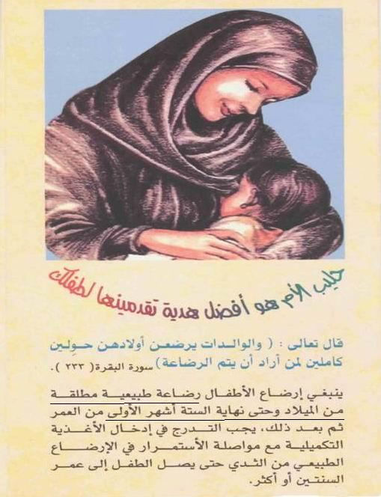

Slide 13
1- “The first two years of a child’s life are a critical window during which the foundations for healthy growth and development are built. Infant and young child feeding is a core dimension of care in this period.”
2- “Breastfeeding plays an essential and sometimes underestimated role in the treatment and prevention of childhood illness."
Complementary feeding: WHO Report of the Global Consultation, Geneva, 10-13 December 2001.

Slide 14
Both WHO and AAP stress the value of breastfeeding for both children and mothers .
Gartner LM, et al (2005). "Breastfeeding and the use of human milk". Pediatrics 115 (2): 496–506.

Slide 15

WHO RECOMMENDATION
Exclusive breastfeeding for 6 months is the optimal way of feeding infants.
Thereafter infants should receive complementary foods with continued breastfeeding up to 2 years of age or beyond.
To enable mothers to establish and sustain exclusive breastfeeding for 6 months, WHO and UNICEF recommend: Initiation of breastfeeding within the first hour of life .
"Exclusive Breastfeeding". WHO: Child and Adolescent Health and Development: Breastfeeding. Retrieved on 2008-09-22.

Slide 16
According to a WHO 2001 report, alternatives to breastfeeding include:
1- Expressed breast milk from an infant’s own mother
2- Breast milk from a healthy wet-nurse or a human-milk bank
3- A breast-milk substitute fed with a cup, which is a safer method than a feeding bottle and teat.
World Health Organization(24-11-2001)."Infant and Young Child Nutrition: Global strategy for infant and young child feeding”, WHO Executive Board 109th Session provisional agenda item 3.8 (EB109/12).

Slide 17
American Academy of Pediatrics (AAP)
Recommendation
"Breastfeeding should be continued for at least the first year of life and beyond for as long as mutually desired by mother and child... Increased duration of breastfeeding confers significant health and developmental benefits for the child and the mother... There is no upper limit to the duration of breastfeeding and no evidence of psychologic or developmental harm from breastfeeding into the third year of life or longer." (AAP 2005)

Slide 18
American Academy of Pediatrics (AAP)
“ Extensive research, especially in recent years, documents diverse and compelling advantages to infants, mothers, families, and society from breastfeeding and the use of human milk for infant feeding.
These include health, nutritional, immunologic, developmental, psychological, social, economic, and environmental benefits “
"Breastfeeding and the Use of Human Milk - AAP policy statement". February 2005. Retrieved on 2008-08-08.

Slide 19

International Breastfeeding Symbol
الشعار العالمي للرضاعة الامومية

Slide 20
Medical Aspects of Human Lactation :
Breastfeeding provides multiple lifelong biologic advantages to children, including increased survival and improved neurocognitive and immune functioning.
These and other advantages have been linked to breast milk components, including long chain fatty acids, epithelial growth factor, immune stimulating cells, and live maternal immune cells (lymphocytes and plasma cells), which survive gastrointestinal transport and implant in neonatal tissues.

Slide 21
Advantages of breastfeeding for infants
1-Availability.
2-Cheap .
3- Always the right temperature and sterile.
4- Balanced diet .
5- Improves mother infant bonding.
6- Improves immune status (Anti-infective).
7- Improves neurocognitive functions and I.Q.
8- Anti-anemic.
9- Anti-allergic.
10- Anti-ricketic.

Slide 22
Preparation of Breast for Lactation:-
Fertilization Pregnancy Labour
Lactation.
a) During pregnancy:
estrogen ;progesterone ; placentae lactogen
development of acini and duct system
b) In puerperium:
Milk secretion initiated by prolactin.

Slide 23
Advantages of breastfeeding for mothers
Strengthen the mother-infant bonding .
Natural postpartum infertility(lactation menorrhea).
Decreased postpartum bleeding.
Reduces the risk of breast, ovarian, uterine and endometrial cancers.
Protects against osteoporosis.
Reduces the risk of rheumatoid arthritis and DM.
Decrease insulin requirements in diabetic women.
Breastfeeding mothers tend to lose weight easier, and earlier return to pre-pregnancy weight.

Slide 24
Breastfeeding(Human Lactation)
1- Nutrition Growth and increased survival
2- Immunity Improved immune functioning and prevent infection.
3- C.N.S Improved neurocognetive functions and I.Q.
4- Stem Cells Tissue engrafment?

Slide 25
Balanced diet:
Human breast milk has just the right amount of fat, sugar, water, and protein that is needed for a baby's growth and development.
"Benefits of Breastfeeding". U.S. Department of Health and Human Services. Retrieved on 2007-01-23.

Slide 26
Balanced diet:
1- Protein: 70% soluble ; easily digested.
2- Fat: essential long chain ; DHA , ARA, needed for
CNS & retina development.
3- High lactose / galactose →brain growth.
4- High fat: in hind milk →satiety.
5- High cholesterol: myelination of nervous system.
6- High content of vit -E,C,D,A and niacin
7- Colostrum: increasing zinc →prevent necrotizing enterocolitis.

Slide 27
Colostrum
Bright lemon yellow ; viscous fluid secreted during first 5-7 days.
Compared to mature milk it is :
1- Very rich in immunoglobulins especially IgA , leucocytes ( macrophages ,
lymphocytes ) and antibacterial ( lactofissin , lactofirrin )
2- Colostrum contains approximately 5 million cells per mL, an amount
that decreases tenfold in mature milk.
3- Rich in cholesterol , Na , K , Cl , Zinc , Copper , and in Vit.A than mature milk.
4- More rich in protein (2.3gm/dl) but less CHO or fat.
5- Laxative effect by enhancing GIT motility.

Slide 28
Colostrum
Most of these leukocytes are macrophages and neutrophils,
which phagocytose microbial pathogens.
Lymphocytes, including T cells, natural killer cells, and antibody-producing B cells, make up 10% of the leukocytes in human breast milk.
There is evidence to suggest that these cells survive passage through the infant’s gastrointestinal system where they are absorbed and influence the infant’s immune response
J Am Osteopath Assoc. 2006;106:203–207

Slide 29
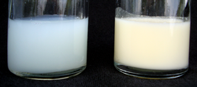
Balanced diet: The foremilk and the hindmilk
Two 25ml samples of human breast milk.
The left hand sample is foremilk, the watery milk coming from
a full breast (High glucose)
The right hand sample is hindmilk, the creamy milk coming from
a nearly empty breast. (High fat)

Slide 30
Breastfeeding Improves IQ
Extensive research on the relationship between cognitive achievement (IQ scores, grades in school) and breastfeeding has shown:
1- Those who were breastfed had significantly higher intelligence quotient scores than comparable children breastfed for less time. The greatest gains for those children breastfed the longest.
2- “Breast-feeding is accompanied by about a five-points higher IQ than in bottle-fed infants,"
3- The effect of Omega-3 fatty acids -docosahexaenoic acid (DHA) and arachidonic acid (AA) - that are prevalent in breast milk but absent in infant formula.
"Breastfeeding and Later Cognitive and Academic Outcomes“
Pediatrics Vol. 101 No. 1 ,January 1998

Slide 31


Slide 32
Cognitive performance similar to infants nourished
with breast milk

Slide 33
Breastfeeding, the Immune Response, and Long-term Health
Human breast milk provides immunologic protection against many infections mainly: diarrheal diseases, otitis media and respiratory diseases
Influence immune system development, affecting the pathogenesis of autoimmune disorders, including atopic allergies and the pathogenesis of chronic disease.
JAOA • Vol 106 • No 4 • April 2006 • 203-207

Slide 34
Immunologic Factors in Human Breast Milk
Secretory Ig A (sIgA).
Leukocytes: Mostly are macrophages and neutrophils, which phagocytose microbial pathogens.
Lymphocytes, including T cells, natural killer cells, and antibody-producing B cells, make up 10% of the leukocytes in human breast milk. These cells survive passage through the infant's gastrointestinal system where they are absorbed and influence the infant's immune response.
Lysozyme: inhibits the growth of many bacteria.
Lactoferrin : limits bacterial growth by removing essential iron
Nucleotides : enhance immune function in infants.
Complex sugars: prevent adherence of various microbial pathogens

Slide 35
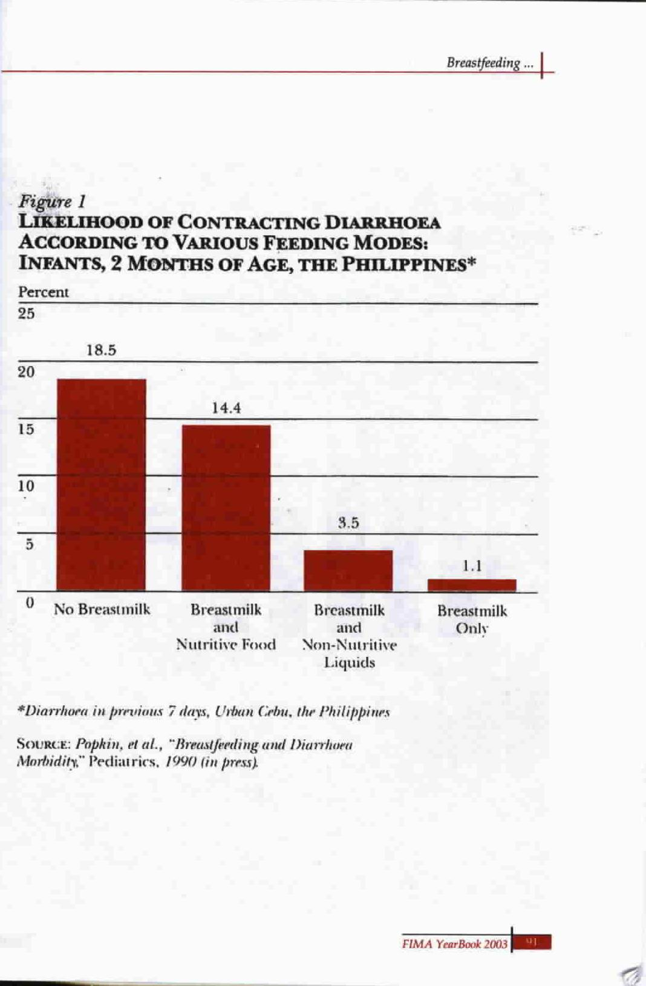

Slide 36
Breastfeeding and HIV/AIDS
When a mother has HIV, the dangers of not breastfeeding must be balanced against the risk of HIV transmission
1.Advice for HIV-positive mothers in developed countries
They should avoid breastfeeding altogether because the risk of HIV transmission far outweighs the risks associated with replacement feeding. Nevertheless the UK Department of Health advises that “Under exceptional circumstances, and after seeking expert professional advice on reducing the risk of transmission of HIV through breastfeeding, a highly informed and motivated mother might be assisted to breastfeed.”
Department of Health, "HIV and Infant Feeding: Guidance from the UK Chief Medical Offices' Expert Advisory Group on AIDS“ ,September 2004.

Slide 37
Breastfeeding and HIV/AIDS
2. Advice for HIV-positive mothers in developing countries
In countries with fewer resources, where replacement feeding can be much more hazardous: exclusive breastfeeding is recommended.
“When replacement feeding is acceptable, feasible, affordable, sustainable and safe, avoidance of all breastfeeding by HIV-infected mothers is recommended. Otherwise, exclusive breastfeeding is recommended during the first months of life.”
WHO, "New data on the prevention of Mother-to-Child Transmission of HIV and their policy implications, 2001

Slide 38
Breastfeeding and HIV/AIDS
3. conclusion:
A study of nearly three thousand mothers in South Africa confirmed that mixed feeding carries a higher risk of HIV infection than exclusive breastfeeding.
The team who conducted the research suggested that WHO infant feeding guidelines should be revised in favour of exclusive breastfeeding.
Coovadia et al, "Mother-to-child transmission of HIV-1 infection during exclusive breastfeeding in the first 6 months of life: an intervention cohort study", The Lancet 369(9567), 31 March 2007

Slide 39
Breastfeeding, the Immune Response, and Long-term Health
Human breast milk provides immunologic protection against many infections mainly: diarrheal diseases, otitis media and respiratory diseases
Influence immune system development, affecting the pathogenesis of autoimmune disorders, including atopic allergies and the pathogenesis of chronic disease.
JAOA • Vol 106 • No 4 • April 2006 • 203-207

Slide 40
Allergy, Autoimmunity, and Breastfeeding
Breastfeeding decrease individuals' future susceptibility to autoimmune disorders, namely:
Allergic rhinitis and atopic allergies.
Crohn's disease and ulcerative colitis .
IDDM or diabetes-related auto-antibodies.
-----------------------------------------------------------------------------------
1- Van Odijk J,et al. Breastfeeding and allergic disease: a multidisciplinary review of the literature (1966–2001) .Allergy. 2003;58:833 –843.
2- Corrao G, et al. Risk of inflammatory bowel disease attributable to smoking, oral contraception and breastfeeding in Italy. Int J Epidemiol. 1998;27:397–404
3- Sadauskaite-Kuehne V, et.al( Longer breastfeeding is an independent protective factor against development of type 1 diabetes mellitus in childhood.) Diabetes Metab Res Rev. 2004;20:150 –157

Slide 41
Breastfeeding can be helpful for preventing allergy by:
reducing exposure to potential allergens.
speeding maturation of the protective intestinal barrier in baby's gut.
coating the gut and providing a barrier to potentially allergenic molecules.
providing anti-inflammatory properties that reduce the risk of infections (which can act as allergy triggers).

Slide 42
Breast milk vs. Formula
 | Breast milk | Formula
Convenience | Always available, premixed and warmed. | May require some preparation.
Hygiene | Sterile | Requires clean containers and water.
Immunology | Maternal IgA | N/A
Bonding | Maternal-Infant bonding. Also may pump. | Can bond with any appropriate care giver.
Vitamins/ Minerals | Bioavailable iron. Insufficient Vitamin D. | Iron usually added. Vitamin D added.
Fat | Omega-3 fatty acids | N/A
Protein | Lactoferrin (E. coli protective iron-binding protein) | Cow’s milk protein allergies/eczema

Slide 43
Human milk contains stem cells :
Inclusion of stem cells in the cellular components of breast milk, with the possibility of passage to the newborn.
Establishment of lactation-derived stem cells in infant tissues, with future possible life long effects.

Slide 44
J Hum Lact. 2006 Aug;22(3):270-1.
  Breast milk: an unappreciated source of stem cells.
    McGregor JA,
    Rogo LJ.
  Columbia University School of Medicine.
  PMID: 16885486 [PubMed - indexed for MEDLINE]

Slide 45
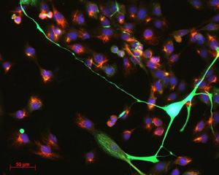
Breast milk contains stem cells
Mammary stem cells (red/blue) and differentiated adult mammary
cells (green) isolated from human breast milk

Slide 46
Identification of nestin-positive putative mammary stem cells in human breastmilk
Mark D. Cregan , et.al
Journal Cell and Tissue Research Volume 329, Number 1 / July, 2007

Slide 47
Abstract Stem cells in mammary tissue have been well characterised by using the mammary stem cell marker, cytokeratin (CK) 5 and the mature epithelial markers CK14, CK18 and CK19. As these markers have never been reported in cells from breastmilk, the aim of this study has been to determine whether mammary stem cells are present in expressed human breastmilk. Cultured cells from human breastmilk were studied by using immunofluorescent labelling and reverse transcription/polymerase chain reaction (RT-PCR). We found a heterogeneous population of cells with differential expression of CK5, CK14, CK18 and CK19. Further, by using the multipotent stem cell marker, nestin, we identified cells in culture that were positive only for nestin or double-positive for CK5/nestin, whereas no co-staining was observed for CK14, CK18 and CK19 with nestin. When cells isolated from breastmilk were analysed by using RT-PCR prior to culture, only nestin and CK18 were detected, thereby indicating that breastmilk contained differentiated epithelial and putative stem cells. Furthermore, fluorescence-activated cell-sorting analysis demonstrated, in breastmilk, a small side-population of cells that excluded Hoechst 33342 (a key property of multipotent stem cells). When stained for nestin, the cells in the side-population were positive, whereas those not in the side-population were negative. The presence of nestin-positive putative mammary stem cells suggests that human breastmilk is a readily available and non-invasive source of putative mammary stem cells that may be useful for research into both mammary gland biology and more general stem cell biology.

Slide 48
Dr. Cregan believes that the mother's breast milk:
Provides for the newborn in the same way that the placenta provided for the preborn baby.
Helps ensure that a baby fulfills his genetic destiny.
Human milk stem cells have all the physical characteristics of fetal stem cells , with the potential to differentiate into multiple cell types. This means the cells could potentially be “reprogrammed” to form many types of human tissue.
It highlights again the incredible gap between artificial infant formula and human milk. (formula can never provide the developmental guidance.)

Slide 49
Dr. Mark Cregan concluded:
Human breast milk is a novel source of nestin + putative mammary stem cells which can be obtained non-invasively from lactating women. Thus creating a plentiful and ethical source of stem cells for use in a wide range of applications with regard to mammary gland and stem cell biology.
Identification of nestin-positive putative mammary stem cells in human breast milk
Cell tissue Res (2007) 329:129-136

Slide 50
Human Lactation in Islamic Teaching
1- From the Holy Quran
2- From the traditions of the Prophet Muhammad (PBUH)
3- From the eminent Companions of the Prophet (PBUH) such as Ali ibn Abee Taleb(RA)

Slide 51
ان كلمة (الرضاعة) ومشتقاتها قد تكررت في القرآن الكريم اربع عشر مرة في سبع سور و ثمان آيات كريمات كما في الجدول أدناه :
الكلمة | رقم الآية | اسم السورة | ت
يرضعن ، الرضاعة، فصالاً ،تسترضعوا | 233 | سورة البقرة | 1.
أرضعنكم ، الرضاعة | 23 | سورة النساء | 2.
مرضعة ، أرضعت | 2 | سورة الحج | 3.
ارضعيه المراضع | 7 12 | سورة القصص | 4.
وفصاله | 14 | سورة لقمان | 5.
وفصاله | 15 | سورة الاحقاف | 6.
ارضعن ، فسترضع | 6 | سورة الطلاق | 7.

Slide 52
The word “Breastfeeding” and its synonyms are repeated in the Quran 14 times distributed in 7 Surah (chapters) and 8 Ayaah (verses) as follows:
The word | No. of Ayaah | Name of Surah | No.
يرضعن ، الرضاعة، فصالاً، تسترضعوا | 233 | Al-Baqarrah ( The Cow) | 1.
أرضعنكم ، الرضاعة | 23 | An-Nisa` ( The Women) | 2.
مرضعة ، أرضعت | 2 | Al-Hajj (The Pilgramage) | 3.
ارضعيه المراضع | 7 12 | Al-Qasas (The Stories) | 4.
وفصاله | 14 | Luqman | 5.
وفصاله | 15 | Al-Ahqaaf | 6.
ارضعن ، فسترضع | 6 | Al- Talaaq (The Divorce) | 7.

Slide 53
قال تعالى:
(وَوَصَّيْنَا الْإِنْسَانَ بِوَالِدَيْهِ حَمَلَتْهُ أُمُّهُ وَهْنًا عَلَىٰ وَهْنٍ وَفِصَالُهُ فِي عَامَيْنِ أَنِ اشْكُرْ لِي وَلِوَالِدَيْكَ إِلَيَّ الْمَصِيرُ) [لقمان: 14]
And we enjoined mankind regarding his parents – his mother carried him in weakness upon weakness and his weaning/disengagement from breastfeeding in two years
Chapter 31 – Verse 14

Slide 54
قال تعالى:
(وَأَوْحَيْنَا إِلَىٰ أُمِّ مُوسَىٰ أَنْ أَرْضِعِيهِ)
[ القصص : 7]
And we communicated to the mother of Musa that you give suck to him
Chapter 28 – Verse 7

Slide 55
قال تعالى :
(...ۗ وَإِنْ أَرَدْتُمْ أَنْ تَسْتَرْضِعُوا أَوْلَادَكُمْ فَلَا جُنَاحَ عَلَيْكُمْ إِذَا سَلَّمْتُمْ مَا آتَيْتُمْ بِالْمَعْرُوفِ ۗ وَاتَّقُوا اللَّهَ وَاعْلَمُوا أَنَّ اللَّهَ بِمَا تَعْمَلُونَ بَصِيرٌ)
[ البقرة : 233]
...And if you decide on a foster suckling-mother for your children, there is no sin on you, provided you pay (the lactating mother) what you agreed (to give her) on a reasonable basis...
Chapter 2, Verse 233

Slide 56
قال تعالى:
(حُرِّمَتْ عَلَيْكُمْ أُمَّهَاتُكُمْ وَبَنَاتُكُمْ وَأَخَوَاتُكُمْ وَعَمَّاتُكُمْ وخالاتكم وبنات الأخ وبنات الأخت وأمهاتكم اللاتي أرضعنكم وَأَخَوَاتُكُمْ مِنْ الرَّضَاعَة ) [النساء: 23]
Prohibited to you for marriage are your mothers, and your daughters, and your sisters, and your father’s sisters, and your mother’s sisters, and brother’s daughters, and sister’s daughters, and your foster mothers who breastfed you, and your sisters by virtue of breastfeeding...
Chapter 4 – Verse 23

Slide 57
وقال الرسول الكريم محمد صلى الله عليه وسلم:
( يحرم من الرضاعة ما يحرم من النسب)
رواه الأمام مسلم من حديث عائشة وابن عباس (رض الله عنهما).
( The prohibitions related to Breastfeeding are equivilant (the same) to the prohibitions related to lineage)

Slide 58
عن ابن مسعود رضي الله عنه عن النبي صلى الله عليه وسلم أنه قال :
(لا رضاع إلا ما شد العظم وأنبت اللحم ، أو قال : ما أنشز العظم) .
المحدث: ابن عبدالبر - المصدر: التمهيد - الصفحة أو الرقم: 8/261
( It is not considered “breastfeeding” except that it is sufficient to strengthen the bones and develop the flesh.)
عن عائشة (رضي الله عنها) : خمس رضعات [ أي فيما يحرم من الرضاع ]
المحدث : ابن حجر العسقلاني - المصدر: فتح الباري لابن حجر - الصفحة أو الرقم: 9/50
( Five sessions of breastfeeding) [that is: in what prohibits of the sucks].

Slide 59
- وقال عليه الصلاة والسلام :
(لا تسترضعوا الحمقاء فإن اللبن يورث )
الراوي: عائشة المحدث: الهيثمي - المصدر: مجمع الزوائد - الصفحة أو الرقم: 4/265
( Don’t seek breastfeeding from a foolish woman , as surely the milk “ inherits”.)
- وقال عليه الصلاة والسلام :
(لا تسترضعوا الورهاء)
الراوي: عائشة المحدث: الهيثمي - المصدر: مجمع الزوائد - الصفحة أو الرقم: 4/265
( Don’t seek breastfeeding from a clumsy woman)

Slide 60
وقال الامام علي بن أبي طالب رضي الله عنه وكرم الله وجهه :
(تخيروا للرضاع كما تخيروا للنكاح فإن الرضاع يغلب الطباع )
المستدرك : 2\196
( Let you choose for the breastfeeding [suckling] as what you choose for marriage, because surely the breastfeeding predominates the characters)
وقال الامام علي بن أبي طالب رضي الله عنه وكرم الله وجهه :
(ما من لبن رضع به الصبي أعظم بركة عليه من لبن امه)
الوسائل: 5\175
(There is no milk of greater blessing for a suckling infant than his mother’s milk.)

Slide 61
We conclude from these Islamic teachings on human lactation:
Mother’s breastfeeding is highly encouraged.
Up to two years of nursing is advisable.
Lactation from a “wet-nurse” is the alternative choice next to mother breastfeeding.
Human milk is the best nutrition for infants and not the cows’ milk or its formulae.
Five breastfeeding meals or more(during the 2 years of lactation period) will induce consanguinity and the shared breastfed infants(non related) will be brothers and sisters in lactation .

Slide 62
CONCLUSION & HYPOTHESIS!
Human lactation is the best source of nutrition for proper growth and development for children, as well as prevention of diseases (preventive breastfeeding)
Human milk can induce biological changes in the breastfed non related infant, which can be used as a method for treatment of certain diseases (Therapeutic breastfeeding)

Slide 63
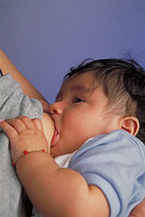
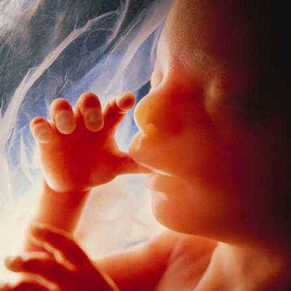
Breastfeeding provides for the infant in the same way that the placenta provided for the preborn baby.
Dr.Mark D. Cregan

Slide 64
THE PROPOSAL
Human lactation leads to brotherhood effects between the infant and the unrelated infants fed by the same breast (wet nurse). A fact which was first stated by the Islamic principles (Quran & Hadith).
This brotherhood is presumably based on many biological changes generated by breast feeding, specially the presence of stem cells in the human milk.
This study aims at investigating these changes which make non related infants, brothers and sisters induced by shared lactation.
Our approach will be either genetic or immunological or both.
Investigating this issue may improve our methods for prevention and treatment of certain diseases (especially hereditary diseases).

Slide 65
Applications of the proposal :
Organ transplantation :
Brotherhood in lactation as a donor for organ transplantation. Better than non-related donor .
Therapeutic breastfeeding :
Treatment of certain diseases for e.g single gene defects (carrier or affected ) diagnosed antenataly or after labour. Feeding those affected infants with human milk from healthy non-related lactating mothers .

Slide 66
Antenatal diagnosis of single gene defect diseases e.g HbS & B-thalassaemia major
(Antenatal diagnosis should be offered if a pregnant woman found to have Hb defect, specially if both are affected as there is a risk of severe fetal Hb defect.
Fetal DNA analysis can be carried out using amniotic fluid, chorionic villus biopsy or fetal blood sample.
Abortion is offered if the fetus is found to be affected ).
Kumar & Clark, Clinical Medicine, 6th ed. 2007, P445.

Slide 67
قال تعالى:
( وَإِنْ تَعَاسَرْتُمْ فَسَتُرْضِعُ لَهُ أُخْرَىٰ) [الطلاق :6]
But if you make difficulties for one another then some other woman may give suck for him.
Chapter 65 – Verse 6

Slide 68
الاستنباطات
أولاً:قوله تعالى: (وإن تعاسرتم)
(التعاسر من العسر وهو نقيض اليسر والعسر استعمله القرآن لضيق النفقة وفي كل أمر صعب كقولك يوم عسر أي يوم يتصعب فيه الأمر والعسر عام يشمل كل مايضيق على الإنسان )
الراغب الأصفهاني / مفردات الفاظ القرآن الكريم
فإن وجود مرض وراثي في الوالدين أو احدهما ينتقل الى الذرية أو أن الأم حامل
بجنين مصاب بمرض وراثي فان الأمرسيكون عسيرا ومشكلا بين الزوجين .
والقاعدة الفقهية تنص أن (العبرة بعموم اللفظ وليس بخصوص السبب)
الذي من أجله نزل الحكم الشرعي .

Slide 69
Therapeutic breastfeeding
وهنا تأتي البشرى بالعلاج المستنبط من القرآن والسنة لهذه الحالات :
فبدلا عن اجراء الاجهاض الطبي للتخلص من الجنين المصاب وهذه العملية محفوفة بالمضاعفات الطبية فضلا عن حرمتها الشرعية.
او بالعلاج بنقل الجينات او زرع نخاع العظم الباهظان الثمن والقليلان النجاح لكثرة مضاعفاتهما ومحدودية المراكز التي تجريهما.
بأن نعهد بهذا الجنين المصاب بعد ولادته الى إمراءة مرضعة من غير أقاربه سليمة وغير مصابة بالأمراض ترضعه بدلا عن أمه أو تشاركها بالرضاعة له ويكون في حليبها الشفاء من هذا المرض الوراثي او على الاقل التقليل من شدته وتخفيف مضاعفاته والله اعلم

Slide 70
The advantages of human milk as a source of stem cell replacement therapy
1- Natural
2- Available
3- Cheap-economical
4- Ethical
5- Non-invasive.
6- No immunosuppression
7- No side effects
8- Effective?? But needs a lot of researches !!

Slide 71
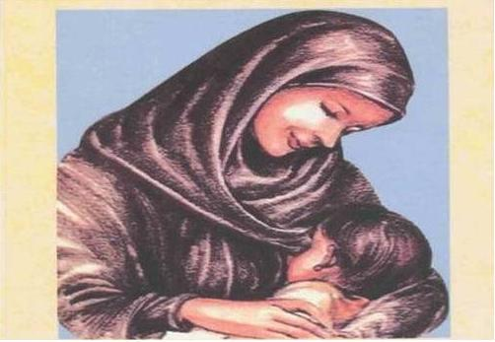
(الرضاعة العلاجية - مستقبل واعد للبشرية)!!
Therapeutic Breastfeeding

Slide 72
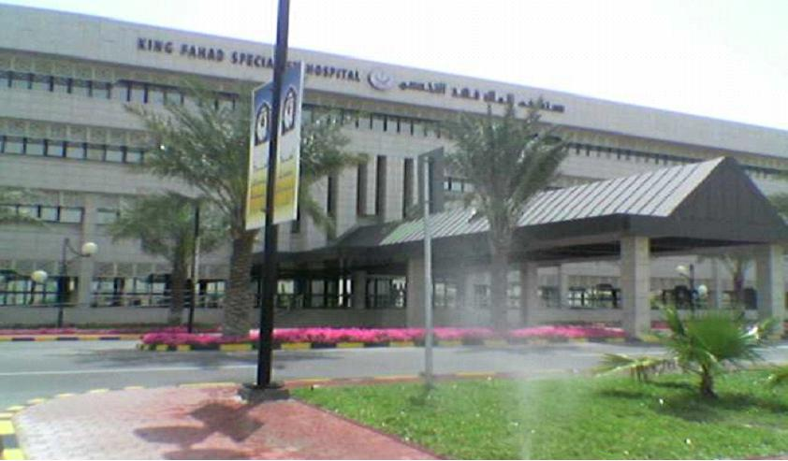
Thank you!

Slide 73
أمْ هوَ الخَـلاق ُ ربُّ الكائناتِ
نطفةٌ تسري برحْم الأمهــاتِ كائنـــــاتٌ مرَّ منها واحـــــــــــدٌ شَــقَّ دربــاً حيث لاقى نصفََـهُ ها هي النبتةُ قد صارت جنيناً ثمَّ طفلاً قد حباه الله رزقاً هل رأيت الشَهدَ حلى مبتداه أخْبِروني كيفَ هذا قدْ جـرى؟ (أَتُرى الصُدْفَةُ صاغتْ وحْدَها |  | تحتـوي آلافِ آلافِ المئـــاتِ شقَّ دَرْباً في خِضَمِّ القنــواتِ فقضى الرحمنُ إنباتَ النباتِ في قرارٍ ومكينِ الجنـبـــــاتِ من حليب هو إحدى المعجزات والغذاء في ختام الرضعات عندَ جوفٍ مُدْلَـهِمِّ الظُلُمَـــاتِ أمْ هوَ الخَـلاق ُ ربُّ الكائناتِ)

Slide 74
THE
TRUTH
(AYAAT)
The Holy QURAN
MANKIND
UNIVERSE
SCIENTIFIC
KNOWLEDGE

