Slide 2
الموضوعات العلمية والطبية في القرآن الكريم

Slide 3
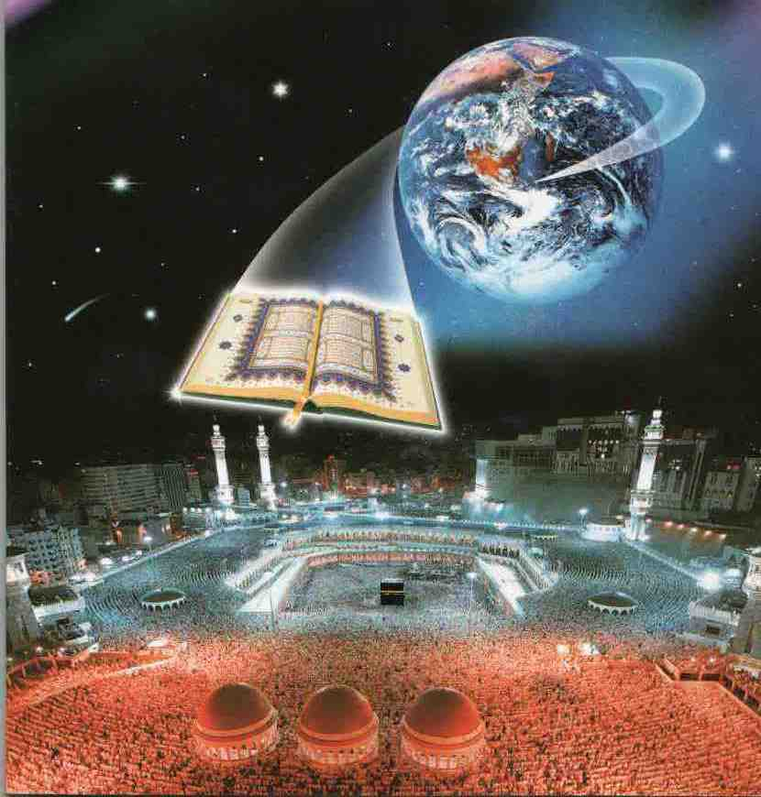
SCIENTIFIC AND MIDICAL TOPICS IN THE GLORIOUS QUR’AN

Slide 4
قال الله تعالى :
” قُلْ أَنْزَلَهُ الَّذِي يَعْلَمُ السِّرَّ فِي السَّمَاوَاتِ وَالْأَرْضِ ۚ إِنَّهُ كَانَ غَفُورًا رَحِيمًا ”
[ الفرقان : 6]
Say: "The (Quran) was sent down by Him who knows the mystery (that is) in the heavens and the earth: verily He is Oft-Forgiving, Most Merciful.“
Al-Furqan: Verse 6

Slide 5
الدكتور محمد جميل حبال
استشاري الطب الباطني
عضو وزميل الكليات الطبية الملكية البريطانية
مستشفى الرعاية التخصصية (بروكير)-الخبر
الخبر - المملكة العربية السعودية
Dr. Mohammad Jamil Habbal
(Consultant Physician)
MRCP (UK), FRCP (Ed), FRCP (London)
E-mail:alhabbal45@yahoo.com
Web site: www.alhabbal.info/dr.mjamil

Slide 6
Main topics
The message of the Holy Quran.
The number of medical and cosmic verses (ayaat) in the Holy Quran (ayaat with scientific reference).
The Holy Quran and science.
The Quranic system in the mankind and universe.
The two books (The Holy Quran and the universe).
Examples of the scientific and medical topics in the Holy Quran
The rationale for recurrence of ayaat of scientific reference in The Holy Quran.

Slide 7
The Qur'an is a book of faith (Iman) and guidance (Hidaayah). It is also a way of life which aims for the establishment of a virtuous society. Allah (SWT) says:
" وَنَزَّلْنَا عَلَيْكَ الْكِتَابَ تِبْيَانًا لِّكُلِّ شَيْءٍ
وَهُدًى وَرَحْمَةً وَبُشْرَى لِلْمُسْلِمِينَ”
النحل: 89
"And we have sent down to thee the book explaining all things, a guide, a mercy and glad tidings to Muslims”
(An Nahl:89).

Slide 8
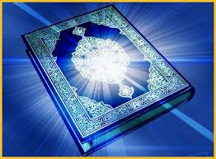
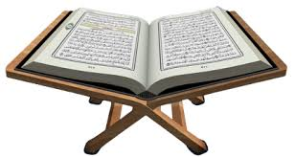
There are many verses (ayaat) in Al Qur’an al Kareem which deal with different branches of science ( medical and cosmic).
We have reviewed and classified these verses according to their scientific topics and also studied the rationale behind their recurrence in the Qur’an.

Slide 9
The results were as follows:
First: There are approximately 1200 ayaat which refer to the different sciences, which constitutes nearly 20% of the total number of ayaat (6236) in Al Qur’an al Kareem.

Slide 10
Second: There are approximately 70 ayaat praising science and scientists, encouraging them to be involved in discovering the universe for the good of humanity. As a matter of fact the first five ayaat revealed to the Prophet Muhammad (PBUH ) ordered him to read and learn.

Slide 11
اقرأ باسم ربك الذي خلق (1) خلق الإنسان من علق (2) اقرأ وربك الأكرم (3) الذي علم بالقلم (4) علم الإنسان ما لم يعلم (5)
العلق: 1-5
Read! In the Name of your Lord, Who has created (1) Has created man from a clot (2) Read! And your Lord is the Most Generous,(3) Who has taught by the pen,(4) Has taught man that which he knew not (5)
Al-Alaq 1-5

Slide 13
جدول يبين عدد الآيات العلمية في القرآن الكريم وحسب موضوعاتها number of Ayaat for each scientific subject
Medicineالعلوم الطبية | 416 |  | Geology علم طبقات الارض | 69
Physicsالفيزياء | 138 |  | Seas & Rivers البحار والأنهار | 35
Biologyالاحياء | 130 |  | Transportation النقل | 28
الفلك وعلم الفضاء Astronomy &Cosmology | 105 |  | أصل الإنسان والمخلوقات الاخرى Origin of Man & others | 27
Geography الجغرافيا | 98 |  | Engineering الهندسة | 12
Agriculture الزراعة | 89 |  | Chemistry الكيمياء | 11
Math. & Statistics الرياضيات | 79 |  | Language of birds & animals لغة الطيور والحيوانات | 8
All of the above & others جميع العلوم الأخرى | > 20

Slide 14
The System of The Holy Quran: in the Universe and Mankind!!

Slide 15
الحق
’’الآيات“
الانسان
’’الأنفس‘‘
القرآن
(الوحي)
الكون
’’الافاق‘‘
العلم
’’المعرفة ‘‘

Slide 16
TRUTH
(AYAAT)
The Holy QURAN
MANKIND
UNIVERSE
SCIENTIFIC
KNOWLEDGE

Slide 17
Human Lactation in the Holy Quran
قال تعالى:
(والوالدات يرضعن أولادهن حولين كاملين لمن اراد ان يتم الرضاعة)
البقرة: 223
The mothers shall give suck to their children for two whole years for those who desire to complete the period of suckling
Chapter 2 – Verse 233

Slide 18
Human Lactation in the Holy Quran
قال تعالى:
(وَأَوْحَيْنَا إِلَىٰ أُمِّ مُوسَىٰ أَنْ أَرْضِعِيهِ)
[ القصص : 7]
And we communicated to the mother of Musa that you give suck to him
Chapter 28 – Verse 7

Slide 19
W.H.O. RECOMMENDATION
Exclusive breastfeeding for 6 months is the optimal way of feeding infants.
Thereafter infants should receive complementary foods with continued breastfeeding up to 2 years of age or beyond.
To enable mothers to establish and sustain exclusive breastfeeding for 6 months, WHO and UNICEF recommend: Initiation of breastfeeding within the first hour of life .
"Exclusive Breastfeeding". WHO: Child and Adolescent Health and Development: Breastfeeding. Retrieved on 2008-09-22.

Slide 20
Human Lactation in the Holy Quran
قال تعالى:
( وَإِنْ تَعَاسَرْتُمْ فَسَتُرْضِعُ لَهُ أُخْرَىٰ) [الطلاق :6]
But if you make difficulties for one another then some other woman may give suck for him.
Chapter 65 – Verse 6

Slide 21
W.H.O. RECOMMENDATION
According to a W.H.O. 2001 report, alternatives to breastfeeding include:
1- Expressed breast milk from an infant’s own mother
2- Breast milk from a healthy wet-nurse or a human-milk bank
3- A breast-milk substitute fed with a cup, which is a safer method than a feeding bottle and teat.
World Health Organization(24-11-2001)."Infant and Young Child Nutrition: Global strategy for infant and young child feeding”, WHO Executive Board 109th Session provisional agenda item 3.8 (EB109/12).

Slide 22
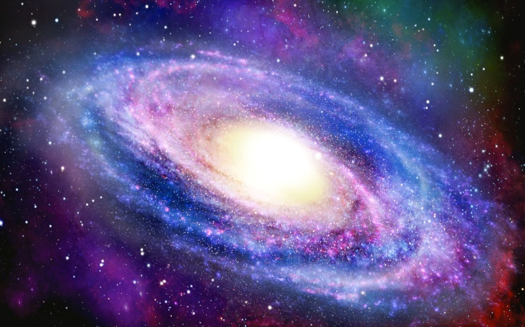
TWO BOOKS !! (Quran and Universe)
1st. The written and readable book !!
(The Quran – words of Allah -SWT)
2nd. The visible book !!
(The universe – created by Allah -SWT)!

Slide 23
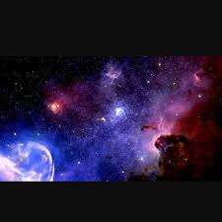
التطابق القرآني الكوني
تَبَارَكَ الَّذِي بِيَدِهِ الْمُلْكُ وَهُوَ عَلَىٰ كُلِّ شَيْءٍ قَدِيرٌ (1)
سورة تبارك الآية 1
تَبَارَكَ الَّذِي جَعَلَ فِي السَّمَاءِ بُرُوجًا وَجَعَلَ فِيهَا سِرَاجًا وَقَمَرًا مُّنِيرًا (61)
سورة الفرقان الآية 61

Slide 24
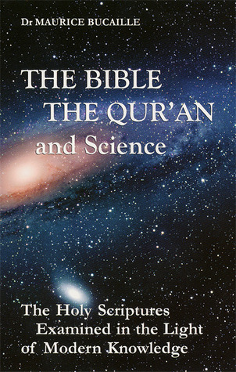
عدم التعارض بين القرآن والحقيقة العلمية
The Quran is in its original form and does not seem to contradict Science
Maurice Bucaille
The Bible, the Qur'an, and Science: The Holy Scriptures Examined in the Light of Modern Knowledge
by Maurice Bucaille

Slide 25
Recurrence of the following words in Holy Quran
Day : 365 times .
Month : 12 times .
Moon : 27 times .
Sun : 33 times .
Sun and Moon in same Ayaah : 19 times.

Slide 26
Examples of the Matching between ASTRONOMY and THE GLORIOUS QUR’AN
The word DAY was repeated 365 times ( same number of days /year)
The word MONTH was repeated 12 times (same number of months/year)
قال تعالى : (إِنَّ عِدَّةَ الشُّهُورِ عِنْدَ اللَّهِ اثْنَا عَشَرَ شَهْرًا فِي كِتَابِ اللَّهِ يَوْمَ خَلَقَ السَّمَاوَاتِ وَالْأَرْضَ )
التوبة: 36
The number of months in the sight of Allah is twelve (in a year)- so ordained by Him the day He created the heavens and the earth
At-Tawba (36)

Slide 27
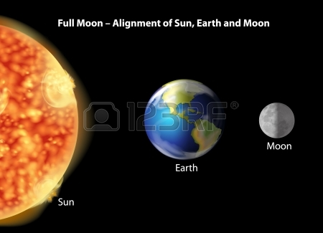
Sun and Moon in the Glorious Qur’an
The word Sun was repeated (33) times
The Solar astronomical cycle is repeated every (33) years
The word Moon was repeated (27) times, which is the number of days of the lunar month calculated from the nearest star, as the sun, it is equal to 27.3 days

Slide 28
Revolution is 27.3 days. One lunar month, on earth requires 29.5 days.

Slide 29
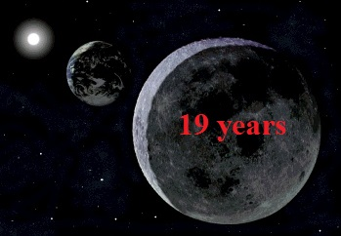
The combined words )Sun & Moon ) were repeated 19 times pointing to the Metonic Cycle which is repeated every 19 years

Slide 30
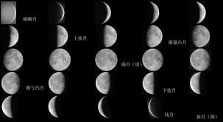
Metonic Cycle/19 years

Slide 31
وَأَنْزَلْنَا الْحَدِيدَ فِيهِ بَأْسٌ شَدِيدٌ وَمَنَافِعُ لِلنَّاسِ And We also sent down iron in which there lies great strength and which has many uses for mankind (Al-Hadid / The Iron -25)
Iron in Quran and Medicine

Slide 32
Iron in Quran and Medicine
قال تعالى :(وَأَنْزَلْنَا الْحَدِيدَ فِيهِ بَأْسٌ شَدِيدٌ وَمَنَافِعُ لِلنَّاسِ )[الحديد : 25].
تطابق العدد والوزن الذري لعنصر الحديد Fe⁺ مع ترتيب سورة الحديد في القرآن الكريم ورقم الآية المذكورة فيه.
ترتيب سورة الحديد في المصحف | رقم آية الحديد في سورة الحديد | الخواص الذرية لعنصر الحديد
ــــــــــ | 26 * | 26 | Atomic No.
57 ** | ـــــــــ | 56 | Atomic Wt.
* رقم الآية يشمل آية البسملة في أول السورة .
** يمثل هذا الرقم ترتيب سورة الحديد الذي هو بداية النصف الثانـي من القـرآن الكريم البالغ عدد سوره ( 114 ) سورة.

Slide 33
The 7 layers of Earth and Fe in the center (Inner Core)

Slide 34
وَأَنْزَلْنَا الْحَدِيدَ فِيهِ بَأْسٌ شَدِيدٌ وَمَنَافِعُ لِلنَّاسِ
(الحديد: من الآية 25 او 26 يإضافة البسملة)
قُل لِّلْمُخَلَّفِينَ مِنَ الْأَعْرَابِ سَتُدْعَوْنَ إِلَىٰ قَوْمٍ أُولِي بَأْسٍ شَدِيدٍ
سورة الفتح الاية 16
فَإِذَا جَاءَ وَعْدُ أُولَاهُمَا بَعَثْنَا عَلَيْكُمْ عِبَادًا لَّنَا أُولِي بَأْسٍ شَدِيدٍ
سورة الاسراء الاية 5
قَالُوا نَحْنُ أُولُو قُوَّةٍ وَأُولُو بَأْسٍ شَدِيدٍ وَالْأَمْرُ إِلَيْكِ فَانظُرِي مَاذَا تَأْمُرِينَ
سورة النمل الاية 33

Slide 35
جدول يبين توزيع مادة الحديد في جسم الإنسان بالـ (مغم) مع النسبة المئوية Distribution of Fe in the Human body
المادة | الكمية (مغم) mg | percentage%
الهيموغلوبين (Hb) | 2500 | 62.5
المايوغلوبين (Mb) وإنزيم Cytochrom P450 | 500 | 12.5
الحديد المنقول على شكل (Transferrin) | 3 | 0.075
الحديد في مخازنه (RES) على شكل Ferritin and Hemosiderin | 600 ـ 1000 | 25
المجموع | ~ 4000 | 100
ملحوظة : كمية الحديد في جسم الانسان ( المرأة ) اقل من الانسان (الرجل) بنحو ( 1 ) غم

Slide 36
كريات الدم الحمراء والهيموغلوبين والذي مركزه الحديد Fe RBC , Hb and Iron (Heam)

Slide 38
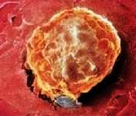
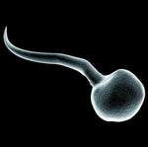
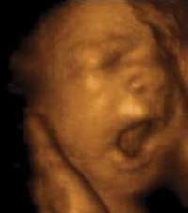
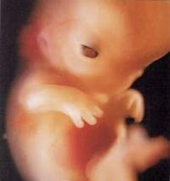
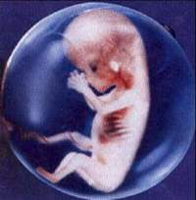
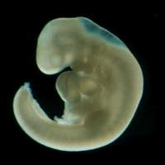
علم الجنين البشري Human Embryology
(وَلَقَدْ خَلَقْنَا الْإِنْسَانَ مِنْ سُلَالَةٍ مِنْ طِينٍ ثُمَّ جَعَلْنَاهُ نُطْفَةً فِي قَرَارٍ مَكِينٍ ثُمَّ خَلَقْنَا النُّطْفَةَ عَلَقَةً)
3
2
1
فَخَلَقْنَا الْعَلَقَةَ مُضْغَةً فَخَلَقْنَا الْمُضْغَةَ عِظَامًا فَكَسَوْنَا الْعِظَامَ لَحْمًا ثُمَّ أَنْشَأْنَاهُ خَلْقًا آَخَرَ
7
6
5
4
فَتَبَارَكَ اللَّهُ أَحْسَنُ الْخَالِقِينَ [ المؤمنون : 12- 14]

Slide 39
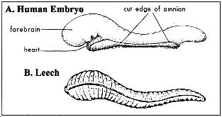
مرحلة العلقة Stage of Leech

Slide 40
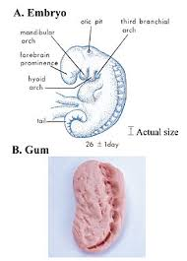
مرحلة المضغة Stage of gum

Slide 41
Keith Moore stated that all stages mentioned in the Quran about the development of human embryo are quite applicable with stages discovered by the embryologists recently!
( انني اشهد باعجاز الله في خلق كل طور من اطوار الجنين المذكورة في القرآن الكريم . ولست اعتقد ان محمدا صلى الله عليه وسلم أو اي شخص آخر يستطيع معرفة مايحدث في تطور الجنين في ذلك الوقت . لان هذه التطورات لم تكتشف الا في الجزء الاخير من القرن العشرين . واريد ان اؤكد على ان كل شيء قرأته في القرآن الكريم عن نشأة الجنين وتطوره في داخل الرحم ينطبق على كل ما اعرفه من علم الاجنة ، كوني أحد العلماء المتخصصين في هذا العلم) . كيث مور - مؤتمر الاعجاز العلمي للقرآن والسنة - القاهرة 1986م

Slide 42
مراحل خلق الجنين البشري )كيث مور Keith Moore (

Slide 43
Embryology in the Qur'an by Dr. VN Persaud.. Consultant Anatomist and Embryologist
"The way it was explained to me is that Muhammad was a very ordinary man. He could not read, didn't know [how] to write. In fact, he was an illiterate. And we're talking about twelve [actually about fourteen] hundred years ago. You have someone illiterate making profound pronouncements and statements and that are amazingly accurate about scientific nature. And I personally can't see how this could be a mere chance. There are too many accuracies and, like Dr. Moore, I have no difficulty in my mind that this is a divine inspiration or revelation which led him to these statements."

Slide 44
Conclusion of Dr. Moore and Dr. Persaud
After all these examples we have seen about the scientific miracles in the Holy Quran and all these scientists' comments on this, let us ask ourselves these questions:
Could it be a coincidence that all this recently discovered scientific information from different fields was mentioned in the Quran, which was revealed fourteen centuries ago? Could this Quran have been authored by Muhammad, may the mercy and blessings of God be upon him, or by any other human being? The only possible answer is that this Quran must be the literal word of God, revealed by Him.Source: IslamReligion.com

Slide 45
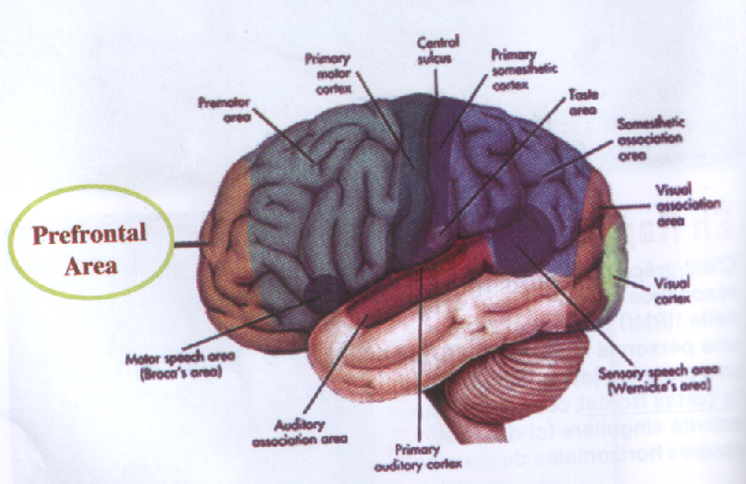
Al-Naasiyah (front of the head & the brain)

Slide 46
The holy Qur’an describes the front of the head in the disbelievers being lying and sinful !!
(ناصية كاذبة خاطئة)
(سورة العلق: 16)
Allah (SWT) says: (a lying sinful nasiyah (front of the head).
(96: 16)

Slide 47
The linguistic meaning of the Ayah
(كلا لئن لم ينته لنسفعا بالناصية. ناصية كاذبة خاطئة)
العلق: 15 - 16
Allah (SWT) says: (Let him beware! If he does not stop, We will take him by the nasiyah, a lying, sinful nasiyah!) (96:15-16) Al-Nasiyah: the front of the head.

Slide 48
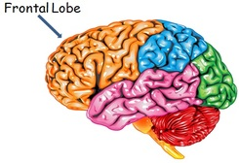
Functions of prefrontal area in the brain:
The function of this part of the brain that lies in the front of the human head (the prefrontal cortex ) is to control the human behavior.

Slide 49
Prof. Dr. Keith Moore, who stated that the front of the head is responsible for judging and for directing human behavior. The working organs of the body (e.g. the limbs or tongue) are but tools to carry out the decision made in the front of the head

Slide 50
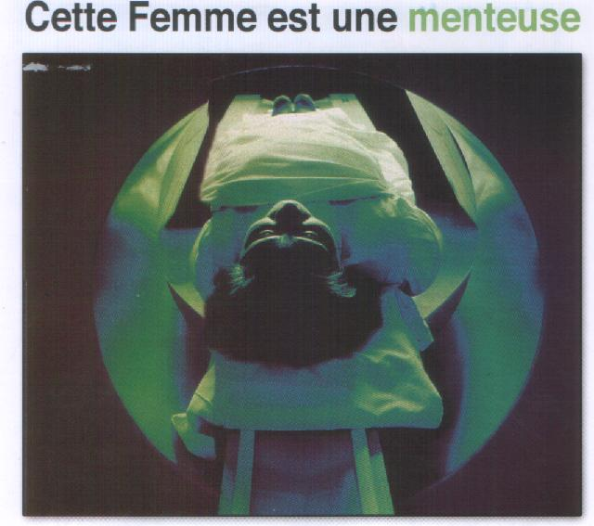
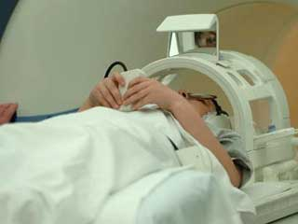
Functional MRI of the brain

Slide 52
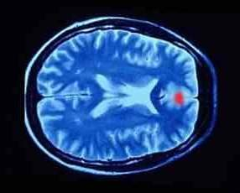
Functional MRI of the brain showing the area of lying in the prefrontal cortex

Slide 53
سجود الدماغ!! Prostration of the brain !!
قال تعالى: (ولله يسجد من في السموات والأرض
طوعاً وكرهاً وظلالهم بالغدو والآصال)
الرعد: 15
Allah (SWT) says in The Holy Quran:
(And to Allah prostrates whoever is within the heaven and the earth, willingly or unwillingly, and their shadows (as well) in the mornings and the afternoons)
Surrah 13: 15

Slide 54
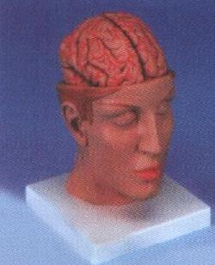
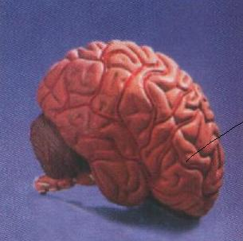
Front and lateral views of the brain in prostration
منظر أمامي وجانبي أيمن للدماغ تماثل إنسان في حالة السجود

Slide 55
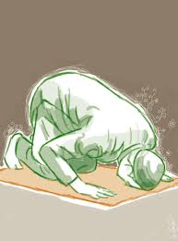

Slide 56
CEREBROSPINAL FLUID (CSF)
Functions
Sterile: The purest fluid in the body!
Origin: Choroid plexus in the brain ventricle.
Volume: about 125 ml
Turn over (Circulation): 5 times during 24 hrs * (Ablution -Wudu For 5 prayers during 24 hrs!)
* Cortex of neuroanatomy,by:Malclom Carpenter,P 28,3rd edition (1999). International student edition, Baltimore-USA.

Slide 57
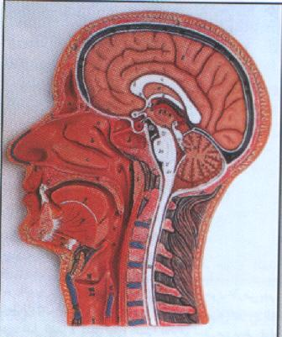
CSF surrounding the brain
Turn over (Circulation) of CSF: 5 times during 24 hrs!
Ablution –Wudu of the brain for 5 prayers during 24 hrs!

Slide 58
الاستنباطات
حصول التوافق بين الحقائق العلمية والآيات القرآنية . حيث أن القرآن هو السابق والعلم هو اللاحق .
كلما ازددنا في معرفة الحقائق العلمية كلما ظهر هذا التوافق فأصبحت العلوم الكونية في خدمة العلوم القرآنية .
في نشر هذه الثقافة تثبيت للمسلمين واقامة الحجة على غيرهم ان هذا الدين هو الحق ،
قال تعالى :
(وَيَرَى الَّذِينَ أُوتُوا الْعِلْمَ الَّذِي أُنْزِلَ إِلَيْكَ مِنْ رَبِّكَ هُوَ الْحَقَّ وَيَهْدِي إِلَى صِرَاطِ الْعَزِيزِ الْحَمِيدِ)
[سـبأ:6]

Slide 59
Conclusions
1-There is a perfect matching between well proofed scientific and medical facts and the glorious Qur'an
2- The glorious Qur'an precedes the newly emerged scientific facts by > 1400 years
3- This means that it contain informations beyond the human knowledge and capabilities
4- The newly emerged scientific facts as in astronomy serve to proof that the Holy Qur'an is the words of ALMIGHTLY ALLAH
5- Spreading these recently discovered scientific informations confirms that Islam the true religion and the Qur'anic facts are the absolute undoutful truth
قال تعالى :
(وَيَرَى الَّذِينَ أُوتُوا الْعِلْمَ الَّذِي أُنْزِلَ إِلَيْكَ مِنْ رَبِّكَ هُوَ الْحَقَّ وَيَهْدِي إِلَى صِرَاطِ الْعَزِيزِ الْحَمِيدِ)
[سـبأ:6]
And those to whom knowledge has come see that the (Revelation) sent down to thee from thy Lord - that is the Truth, and that it guides to the Path of the Exalted (in might), Worthy of all praise
(6) Saba .

Slide 60
كما جاء في قوله تعالى:
(أَلَمْ تَرَوْا أَنَّ اللَّهَ سَخَّرَ لَكُمْ مَا فِي السَّمَاوَاتِ وَمَا فِي الْأَرْضِ وَأَسْبَغَ عَلَيْكُمْ نِعَمَهُ ظَاهِرَةً وَبَاطِنَةً )
[لقمان :20]
Do ye not see that Allah has subjected to your (use) all things in the heavens and on earth, and has made his bounties flow to you in exceeding measure, (both) seen and unseen? Yet there are among men those who dispute about Allah, without knowledge and without guidance, and without a Book to enlighten them!
(20) Luqman
وقوله تعالى:
(إِنَّ هَذَا الْقُرْآنَ يَهْدِي لِلَّتِي هِيَ أَقْوَمُ)
[الإسراء: 9]
9) Verily this Qur´an doth guide to that which is most right (or stable), and giveth the Glad Tidings to the Believers who work deeds of righteousness, that they shall have a magnificent reward;
(9) Al-Israa
Summary
The holy Qur'an is a treasure with an endless sources of scientific knowledge involving all specialties & subspecialties
Each scientist guided by these assured certainty facts can discover and share valuable informations
Ensuring a current and future benefits for all the humanity
And by this we fulfill the istikhlaaf (Succession )

Slide 61
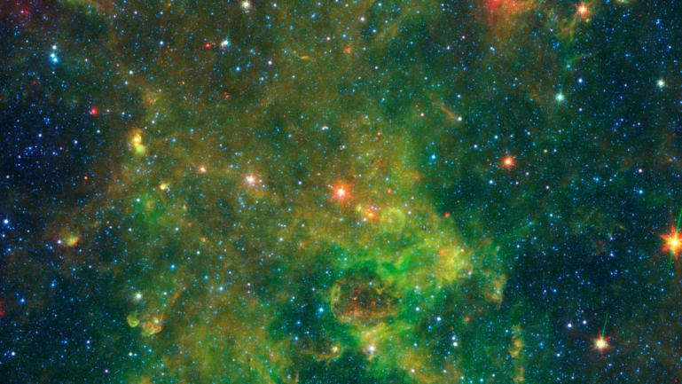
قال تعالى: )سنريهم آياتنا في الآفاق وفي أنفسهم حتى يتبين لهم أنه الحق أولم يكف بربك أنه على كل شيء شهيد( فصلت: 53
We will show them Our Signs in the universe, and in their own selves, until it becomes manifest to them that this (the Qur'an) is the truth Is it not sufficient in regard to your Lord that He is a Witness over all things?
(Surah Fussilat: ayat 53)

